Slide 1
GAR
Session 10: Pokemon
Notes:
Welcome. Today we build Pokemon. The main topic: scenes and UI.
Start by playing the finished game, Pokemon4, before any code.

Slide 2
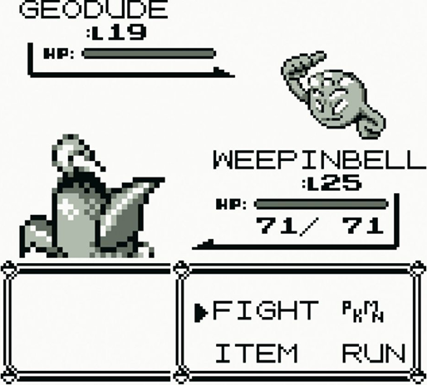
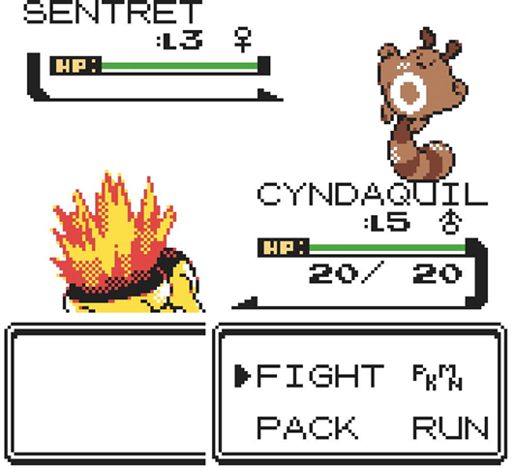
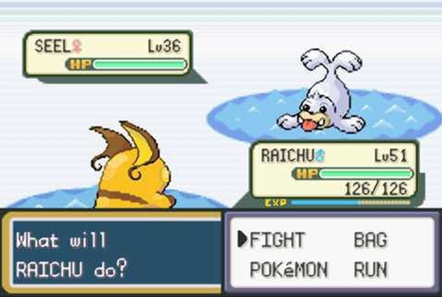
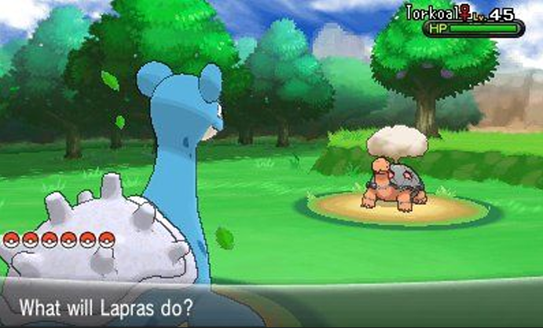

Pokemon
Pokémon, from the first games (Game Freak, 1996) on. Screenshots © Nintendo / Game Freak.
Notes:
The series from the Game Boy to today: a map to walk, and turn-based battles. Ours is the Game Boy kind.

Slide 3
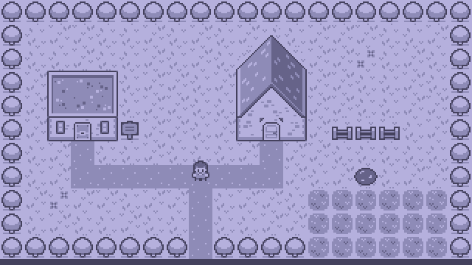
Today’s Goal
Notes:
Run Pokemon4 and play it for a minute.
Ask: what would you need to build this? Collect answers on the board, and come back to them at the end.

Slide 4
Today’s Topics
Main topic: Scenes and UI
State Stack
GUIs & Separating UI from Data
Turn-Based Battles
Service Locator
Save & Load
Tweens (from Zelda)
Notes:
Today’s main topic is scenes and UI. Screens stack on a state stack, with GUI widgets on top. Then turn-based battles, the Service Locator, and saving.

Slide 5
Source Code
github.com/Metamate/gar-games, folder 10-pokemon
Its README: the steps (Pokemon0 to Pokemon4), where things are in the code, how to run it
The course site: today’s concepts in full, the exercises, and questions to check yourself
Notes:
Open gar-games/10-pokemon live. Show the README: the step table, the code map, how to run a step.
Say: the site explains the ideas, the README helps you find them in the code, the slides are for today.

Slide 6
Steps
Pokemon0: the overworld, tile-based movement with tweens
Pokemon1: the state stack (title, fades and dialogue)
Pokemon2: battles (encounters, battle scene and menus; run only)
Pokemon3: turn-based combat and RPG mechanics
Pokemon4: audio through the service locator (the finished game)
Notes:
Five steps; the README has the same table with more detail.

Slide 7
Explore the Codebase
Take ~10 minutes to browse the finished game, Pokemon4. Use the README as a guide if you need it.
Clone the repository and build and play the game
  Go through a few encounters in order to level up your mon!
How is the codebase split between the core library and the pokemon-specific project?
Notes:
Ten minutes: play a few encounters. Then ask how the code is split between GARCore and the game.
The rule: a class that talks about monsters or battles belongs to the game; one you could reuse belongs to GARCore.

Slide 8
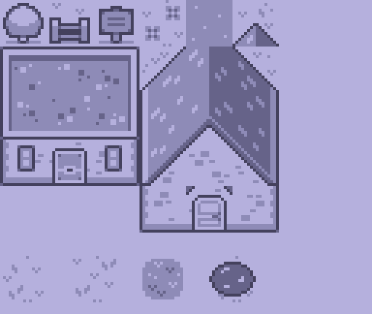
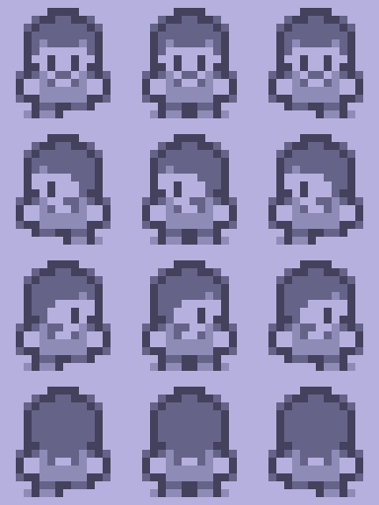
Notes:
The game’s sheets: the town’s tiles and the trainer, in four directions with two steps each.

Slide 9
Problem: Where Were We?
The player is mid-step in the tall grass. A battle starts.
PlayState
the field, the player, the grass
BattleState
the fight
SetState(battle)
thrown away
The battle ends. How do we get back to where we were?
Notes:
Don’t show the next slide yet. Ask the question and let them suggest answers: save the field somewhere? Rebuild it? Keep it, and put the battle on top?

Slide 10
State Stack
Push a state on top; pop it to return to where you were.
Only the top state gets Update
It has the input to itself
BattleMenuState
BattleState
Every state draws, bottom to top
The field and the fight stay visible
PlayState
bottom
Notes:
Push a state on top; pop it and you’re back where you were. Only the top state updates; every state draws, bottom to top.

Slide 11
State Stack Trace
Files: StateStack.cs, BattleState.cs, BattleMenuState.cs, FadeState.cs
A battle just triggered
  List every state on the stack (bottom to top) once BattleMenuState is showing.
Which state gets Update calls? Which states still Draw?
FadeState pushes on top, animates, then pops
  What would break if it swapped the current state instead of push/pop?
Design a PauseState
  where do you push/pop it?
Notes:
In pairs, with the four files open. Take answers: the stack during the menu is PlayState, BattleState, BattleMenuState. For the pause state: push it on P, pop it on P.

Slide 12
Try It: A Message of Your Own
In Pokemon4, PlayState.Update:
Push a DialogueState with your own text when M is pressed
Dismiss it: where does the game carry on?
What did PlayState need to know?
Notes:
Pairs, about 6 minutes. _stack.Push(new DialogueState(_stack, "...")) on WasKeyJustPressed(Keys.M) (add using Microsoft.Xna.Framework.Input).
Dismissing pops it, and PlayState is on top again, as it was. PlayState needs to know nothing about what comes after.

Slide 13

Tweens Everywhere (from Zelda)
One attack is a chain of tweens, where each one’s Finish starts the next.
After(pause)
Lunge
Hit sound
Blink × 6
HP bar drops
The timing lives in the tween system, without flags, frame counters or if/else chains.
Notes:
One attack is a chain of tweens, each Finish starting the next. It needs no flags or frame counters.
Two details: tweens update before states, and a tween started in a callback begins next frame (changing a list while looping over it is a classic bug).

Slide 14
Try It: Slower Fades, Faster Steps
In Pokemon4, GameSettings:
Make the fades twice as slow
Make the walk between tiles twice as fast
Did any state change?
Notes:
Pairs, about 4 minutes. FadeDuration and WalkTweenDuration. No state changes: the timing lives in the tweens.

Slide 15
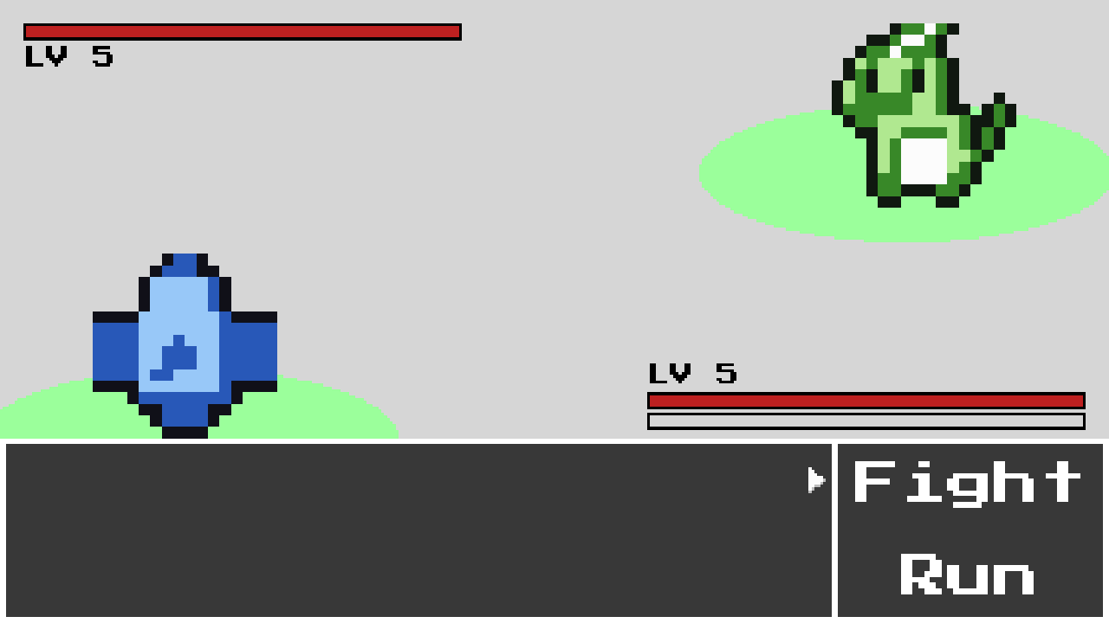
GUIs
Four small widgets, combined into every screen.
ProgressBar
current / max: HP and EXP
Panel
the box behind every widget
Menu = Panel + Selection
labels, actions, the cursor
Textbox = Panel + text
wrapped, one page at a time
Notes:
Four widgets, combined into every screen. Point at each label on the battle screen: the bars, the panels, the menu (a panel plus a selection), the textbox.

Slide 16
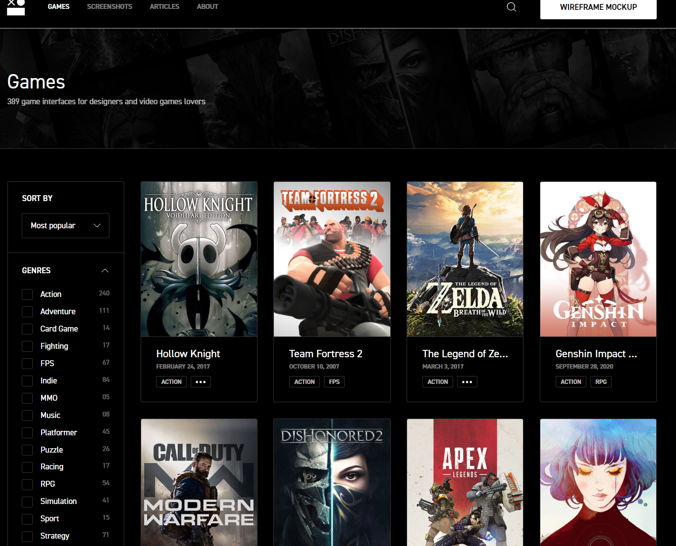
GUIs
interfaceingame.com
Notes:
interfaceingame.com: real game interfaces, for inspiration. For larger UIs, a library like Gum saves a lot of work.

Slide 17
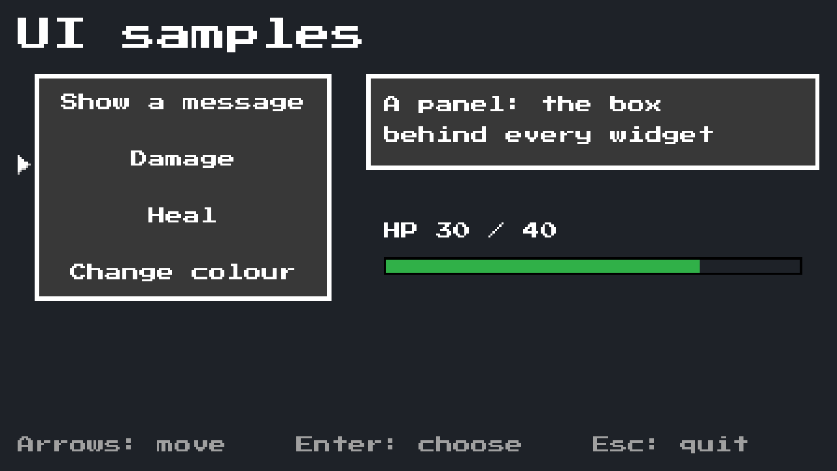
UI Samples
Next to the steps: UiSamples, the widgets on one screen
dotnet run --project UiSamples
A menu, a panel, a progress bar, a textbox
While the textbox is open, the menu waits: focus
Notes:
Demo: run UiSamples. Go through the options: the textbox pages and closes itself, Damage and Heal tween the bar, the colour changes.
Point out focus: while the textbox is open, the arrows do nothing to the menu. SamplesScreen.Update decides who gets the input.
The samples use Pokemon4’s widgets, so a change there changes the game too.

Slide 18
Try It: The Samples
In UiSamples:
Add a fifth option that fills the bar again
Make the bar turn red below a quarter
Which class did each change need?
Notes:
Pairs, about 7 minutes. The option: one line in the menu’s list in SamplesScreen. The colour: in SamplesScreen.Update or Draw, from the bar’s value; ProgressBar itself doesn’t need to change.
Ask: should ProgressBar know about “low”? Answer: better not; the screen decides what low means for its data.

Slide 19
A UI Library?
Our own widgets: small, readable, and you see how a UI works
Gum: layouts, scrolling lists, text input, a visual editor
The cost: a dependency, and a new way of working
Your project: a few menus and bars, build them; an inventory, reach for Gum
Notes:
We build our own because the lesson is how a UI works: drawing, layout, input and focus.
For the projects, Gum is the obvious choice when the UI grows. The site links MonoGame’s Gum tutorials.
Ask: what UI does your game need? Is any of it more than menus, bars and text?

Slide 20
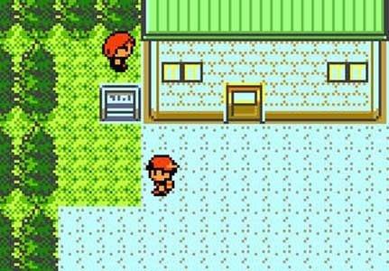
Tile-Based Movement
The logic jumps a whole tile; the sprite glides after it.
MapX, MapY: which tile (the rules use this) · X, Y: where it’s drawn (tweened)
Notes:
The logic jumps a whole tile at once; the sprite glides after it in half a second. MapX and MapY for the rules, X and Y for drawing.

Slide 21
Overworld & Random Encounters
A random encounter is just pushes and pops.
Each fade pops itself when it’s done. The field never knows a battle happened.
FadeState ← white
BattleMessageState
FadeState → white
BattleState
BattleState
PlayState
PlayState
PlayState
1 Fade to white
2 At white: push the battle, fade back
3 The fight
Notes:
An encounter is only pushes and pops: fade to white, push the battle, fade back. The field never knows a battle happened.

Slide 22

Overworld Encounters
How does a battle start?
  Find out where in the code the game transitions from PlayState to BattleState
  What other states are involved in the StateStack at this moment?
  What happens when a battle ends?
Notes:
In pairs: find where the battle starts, and what’s on the stack then. What happens when it ends?

Slide 23
The Battle System
Each phase of a battle is its own state, with one job.
BattleMenuState
the choice
Fight
TakeTurnState
one turn’s events
attack
BattleMessageState
a message, until Confirm
both still standing: back to the menu
BattleState: the scene (sprites, bars), always drawn underneath
With push and pop, no state needs to know which one comes next.
Notes:
Each phase is its own state with one job; BattleState stays underneath and keeps drawing. No state needs to know which comes next.

Slide 24
RPG Mechanics
PokemonSpecies is the type; a Mon is one monster of that type.
PokemonSpecies
name, base stats, growth values, sprites
Mon
level, stats, HP, EXP
is a
// stats follow from the level: no dice
int Attack => BaseAttack + AttackGrowth * Level / 2;
// damage, at least 1
int damage = Attack * move.BasePower / 10 - defender.Defense;
The Type Object pattern again, as in Plants vs. Zombies.
Notes:
A species is the type, a monster one of that type: Type Object again. Stats follow from the level: base plus half the growth value per level. No dice, so a level 5 Cindrel is always the same.
The damage line: attack scaled by the move, minus defence, at least 1.

Slide 25
Monster Battles
Trace one turn: from choosing Fight to the result on screen.
Where is the damage calculated?
How does the game decide the battle is over, and what happens next?
What makes a monster level up, and how do its stats grow?
Notes:
In pairs, with Pokemon4. Take answers: the turn is in TakeTurnState, damage in Mon, the end in TakeTurnState’s checks.

Slide 26
Definition Files
Data in JSON, behaviour in C#.
[
{
"name": "Cindrel",
"baseHp": 12,
"baseAttack": 7,
"hpGrowth": 3,
"battleSpriteFront": "..."
}
]
// a record: just data
public sealed record PokemonSpecies(
string Name,
string BattleSpriteFront,
int BaseHp, ...);
read with System.Text.Json
What does adding a new monster take?
Notes:
The JSON on the left becomes the record on the right. Ask the question: what does a new monster take? A JSON entry and two sprites; no code.

Slide 27

Data-Driven Definitions
Start from Pokemon4. Full instructions are on the course site.
A glass cannon: a new species, only in the JSON
Types: Fire, Water, Grass, and super-effective hits
Save and load the party, with a round-trip test
Notes:
Exercises: a glass cannon, types, save and load.
Full instructions are on the course site; students work from there. Walk round while they work.

Slide 28
Save & Load
Save plain data: only what you need to rebuild the game.
public record SaveData(List<MonSaveData> Party, int MapX, int MapY);
File.WriteAllText(path, JsonSerializer.Serialize(data));
SaveData loaded = JsonSerializer.Deserialize<SaveData>(File.ReadAllText(path));
You forget to save the HP. When do you find out?
What test would find it first?
Notes:
Save plain data: what you need to rebuild the game. Ask the question: you forget the HP; when do you find out? The next time someone loads.
A round-trip test finds it first: save, load, compare.

Slide 29
Service Locator
Many classes need the audio. How do they find it?
Pass it in
explicit, but passed through every layer
Singleton
easy, but tied to one concrete class
Service Locator
one registry, handing out interfaces
Locator.Provide(new SoundManager()); // once, at startup
Locator.Audio.PlayHit(); // anywhere
// until then, Locator.Audio is a NullAudio that does nothing
Geometry Wars tries the first option, dependency injection.
Notes:
Ask the question at the top before showing the boxes. Three answers: pass it in, a Singleton, or a locator.
The locator hands out interfaces, and a NullAudio stands in until the real one is provided. Geometry Wars tries passing things in.

Slide 30
Try It: Silence Without Changes
In Pokemon4, Game1:
Provide a NullAudio instead of the SoundManager
Which other classes did you change?
Then: a LoggingAudio that prints each sound’s name
Notes:
Pairs, about 6 minutes. One line in Game1: Locator.Provide(new NullAudio()). No other class changes: they only know IAudio.
LoggingAudio implements IAudio with a Console.WriteLine per method. Ask: what would the same change cost with Flappy Bird’s Singleton? Every caller names Audio.Instance.

Slide 31
Some Missing Features
Detailed Level-Up Screen
Monster Catching
Field Menu For Browsing Pokemon
Item Inventory
Different Abilities
Other Trainers to Fight
Monster Evolution
Towns, Routes, and Other Levels
Breeding
Day/Night Cycle
Types (Fire/Water/Grass)
Notes:
Everything the real games have that ours doesn’t. Any of these is a good project extension.

Slide 32
Check Yourself
When is a state stack better than a state machine that replaces states?
How does a Service Locator differ from a Singleton?
When would you pass a service in instead?
The answers, and more questions, are on the course site.
Notes:
Ask one question at a time. Pairs discuss for a minute, then take two or three answers.
Expected answers (from the course site):
Q: When is a state stack better than a state machine that replaces states?
A: When you need to return to a previous state as you left it (a pause menu, a battle, a dialogue box), or draw several states on top of each other.
Q: How does a Service Locator differ from a Singleton?
A: Callers depend on an interface, and the implementation can be swapped at runtime (e.g. a null or logging service). It is still global access, so dependencies stay hidden.
Q: When would you prefer dependency injection over a Service Locator?
A: When a class has few dependencies and they are needed close to where the object is created. Constructor parameters make dependencies explicit and easy to replace in tests.

Slide 33
Apply It to Your Project
Would your game benefit from layered states?
  Pause menus, dialogue, transitions
Which services do many of your classes need? How do they get them today?
What would your game need to save to resume a session later?
Notes:
Give the project groups five minutes with these questions.
Ask two groups to share one answer each, and push them to name actual classes and files.

